Slide 1

W.J. Scott
GO Team Business Meeting #3
December 3, 2025

Slide 2

Agenda
Action Items
  Approval of Agenda
  Approval of Previous Minutes
  Additional Action Item
Discussion Items
  2025-2030 Strategic Plan Development
    Confirm Mission/Vision, Goals from Previous Meeting
    Develop 2025-2030 Strategic Plan Objectives
Information Items
  Principal’s Report
  2025 CCRPI Results
  Cluster Advisory Team Report
  Charter System Renewal
  FY27 Budget Preparation
  Attendance
  APS Forward 2040 –Facilities Plan Update
Announcements
Public Comment
Adjournment

Slide 3

Action Items
Approval of Agenda
Approval of Previous Minutes

Slide 4
Discussion Items

Slide 5
Continuing the
2025-2030 School Strategic Plan Development Process

Slide 6
School Strategic Planning Overview
Purpose
To cascade the district strategic plan to the school level, while grounding our focus in the school’s Continuous Improvement Plan. This will create alignment, reduce confusion, and simplify our efforts.
Timeline
Our school’s 2030 Strategic Goals and Objectives should be updated, approved and ranked by January 2026. Schools will focus on the strategies as part of FY27 Budget and Continuous Improvement Plan processes.

Slide 7
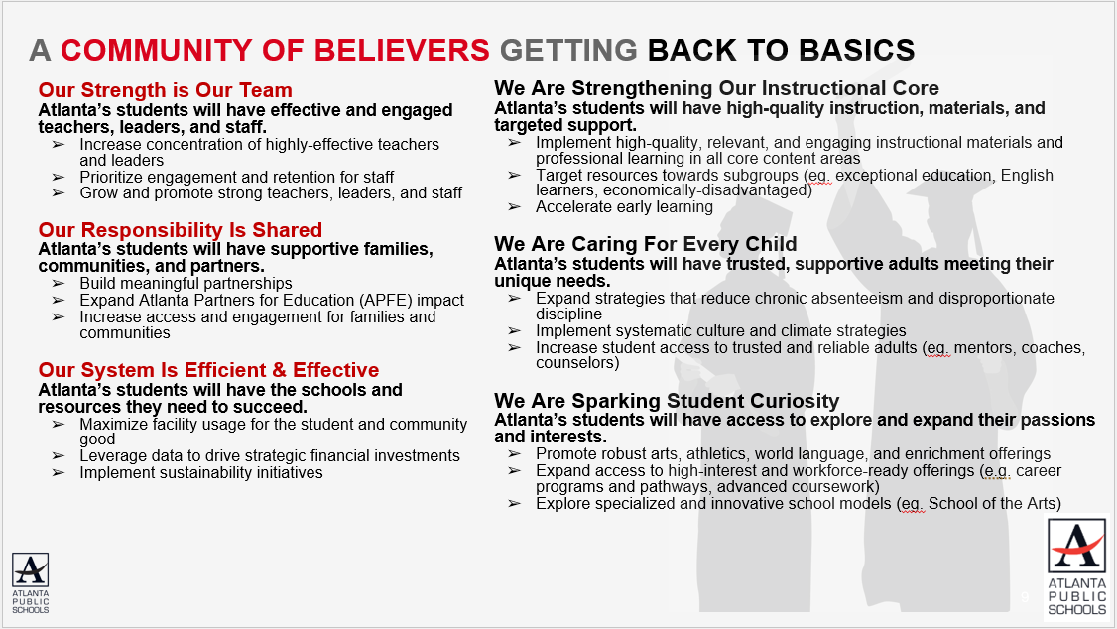
Revisiting the APS 2025-2030 Strategic Plan
Notes:
As a reminder this is the district's 2025-2030 Strategic Plan. We will use this as a guide as we continue our work today to develop our school's 2025-2030 Strategic Plan that is aligned to the district's new plan.

Slide 8
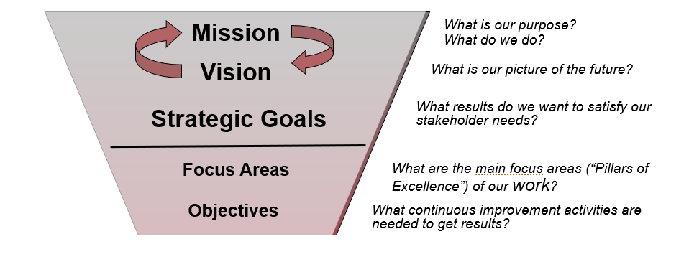
GO Team’s Focus (Governance)
Notes:
These are the governance-aligned portions of the school strategic plan that the GO Team will develop. We will dive into specific strategies and actions, as a part of our budget development process that starts in January.

Slide 9

School Strategic Planning Process Overview
1
Review Data
Sample GO Team Business Meeting Cadence
Business Meeting 1:
Review Data (MAP, GMAS, Graduation Rate, CCRPI, etc.)
Business Meeting 2:
Review Data (School KPIs)
Align Mission/Vision/ Purpose
Confirm 2030 Goals
Business Meeting 3:
Identify 2025-2030 Strategic Objectives
Business Meeting 4 (Budget Allocation):
Approve Your Strategic Plan & Rank Your Strategic Objectives for FY27
2
Align Mission/Vision/Purpose
3
Confirm 2030 Goals
Create CIP Goals to 2030
Identify Additional Goals
4
Identify 2025-2030 Strategic Objectives
Reflect on 2020-2025 Strategic Plan
Review and Discuss Additional Objectives Going Forward
5
Approve Your Strategic Plan & Rank Your Strategic Objectives for FY27

Slide 10
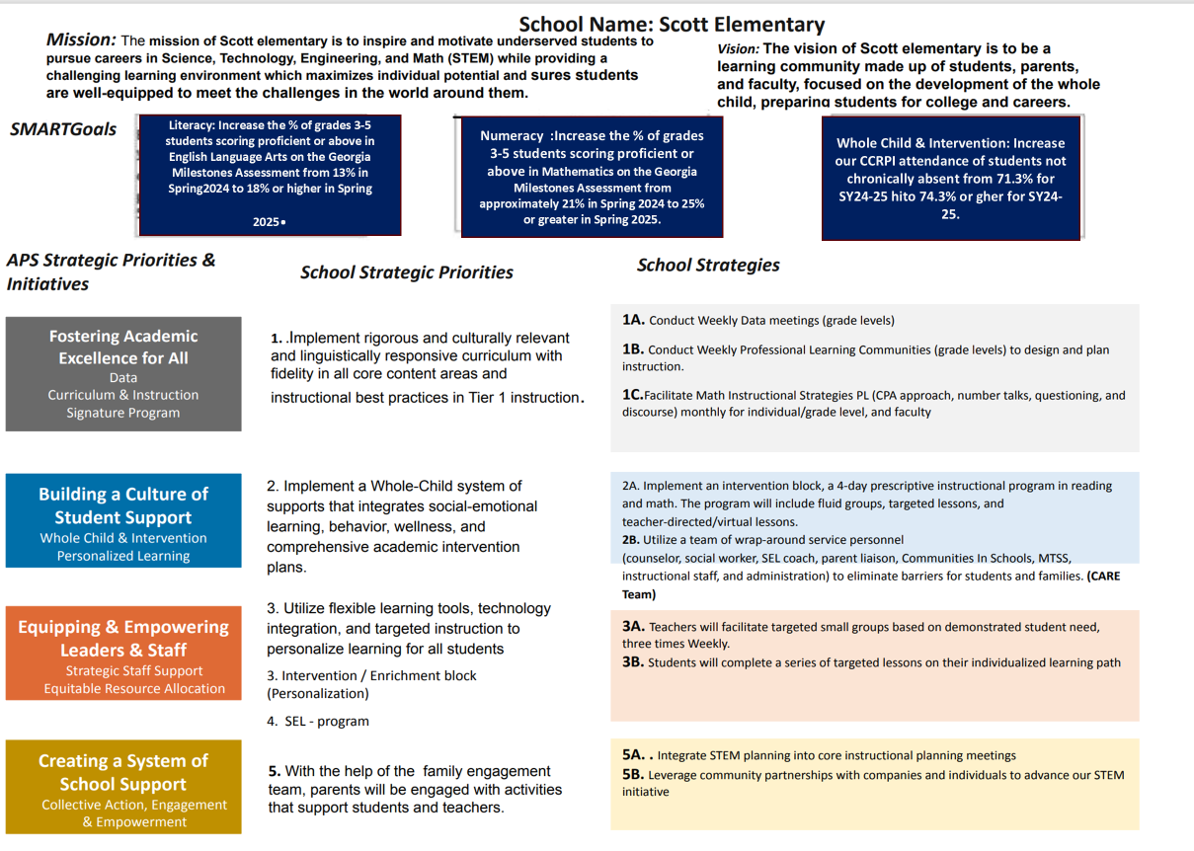

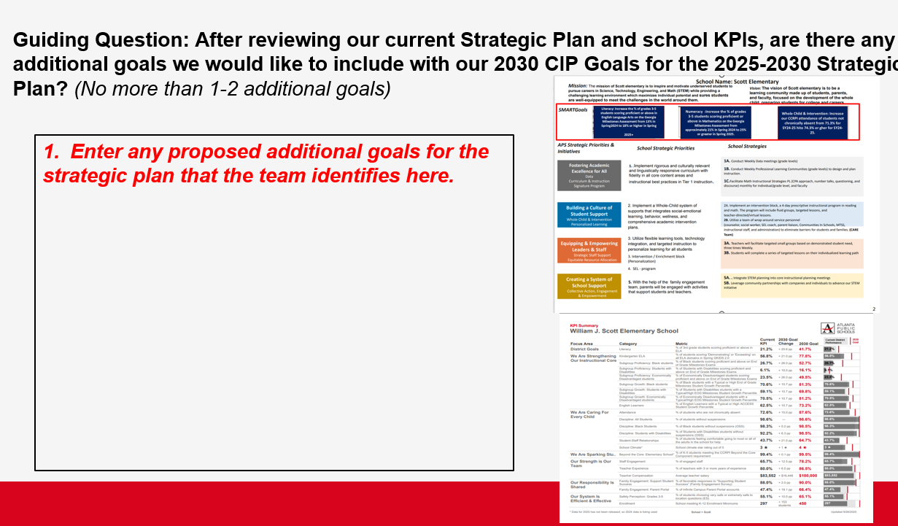
In Our Last Meeting We…
1
Reviewed Our
School Data
2
Aligned Our
Mission and Vision
3
Confirmed Our
2030 Goals

Slide 11
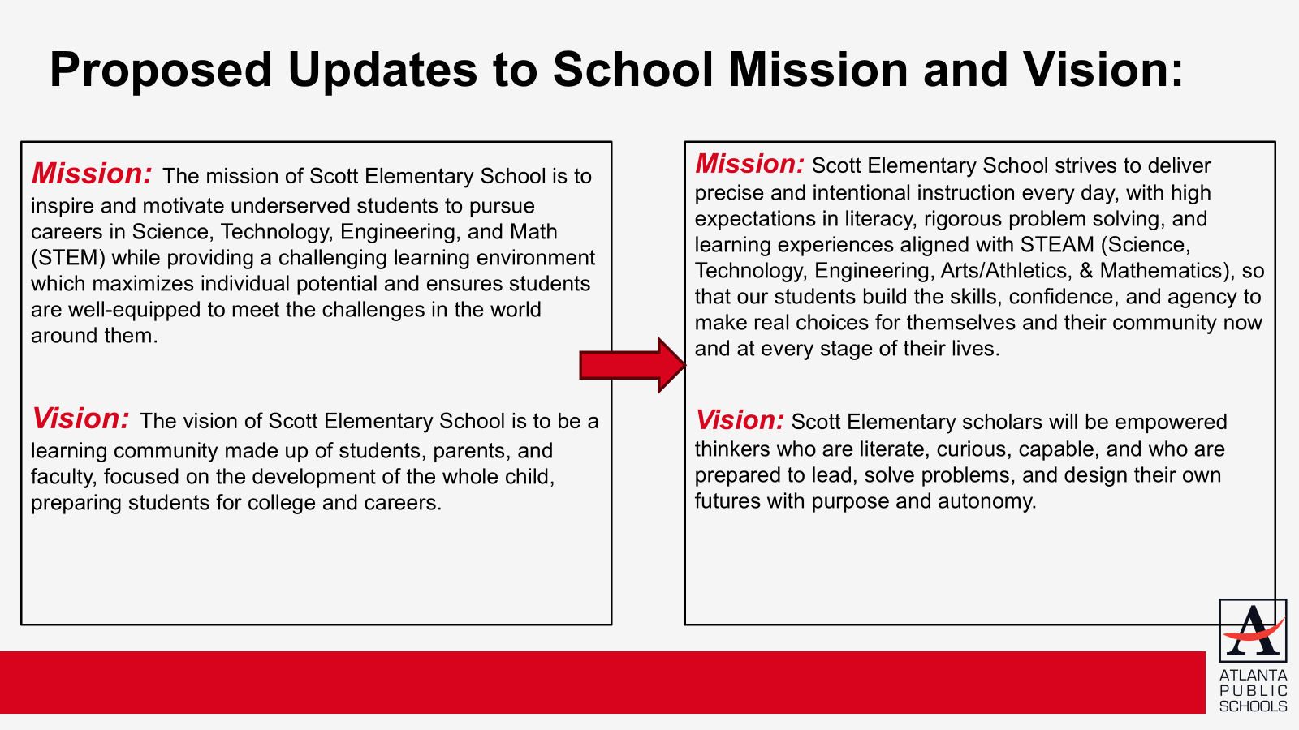

W. J. Scott Proposed Updates to School Mission and Vision:

Slide 12

W. J. Scott Proposed Goals for the 2025-2030 Strategic Plan:
1. By 2030, the percentage of proficient and above learners as assessed by the GMAS EOG ELA will increase overall from 23.5% (2025) to 41.7%.
2. By 2030, the percentage of proficient and above learners as assessed by the GMAS EOG Math will increase overall from 26.5% (2025) to 46.5%.
3. By 2030, the CCRPI attendance rate will remain at or above 87.6%, by ensuring chronic absenteeism as determined by GADOE does not exceed 10% days absent for the student's enrollment period greater than 30 days.

Slide 13

Today’s Focus:
School Strategic Planning Process: Step 4
1
Sample GO Team Business Meeting Cadence
Business Meeting 1:
Review Data (MAP, GMAS, Graduation Rate, CCRPI, etc.)
Business Meeting 2:
Review Data (School KPIs)
Align Mission/Vision/ Purpose
Confirm 2030 Goals
Business Meeting 3:
Identify 2025-2030 Strategic Objectives
Business Meeting 4 (Budget Allocation):
Approve Your Strategic Plan & Rank Your Strategic Objectives for FY27
Review Data
2
Align Mission/Vision/Purpose
3
Confirm 2030 Goals
Create CIP Goals to 2030
Identify Additional Goals
4
Identify 2025-2030 Strategic Objectives
Reflect on 2020-2025 Strategic Plan
Review and Discuss Additional Objectives Going Forward
5
Approve Your Strategic Plan & Rank Your Strategic Objectives for FY27

Slide 14
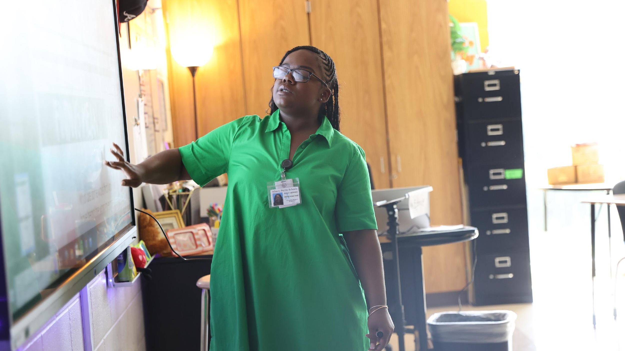

4. Identify 2025-2030 Strategic Objectives
Reflect on 2020-2025 Strategic Plan (Stop, Continue)
Align Objectives to the District's new Focus Areas
Review and Discuss Additional Objectives Going Forward (Start)
One District. One Goal. Every Child.

Slide 15
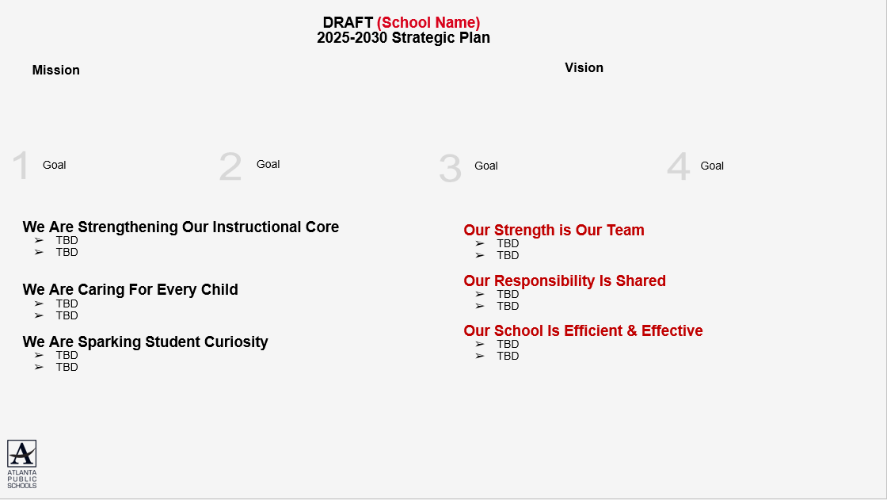
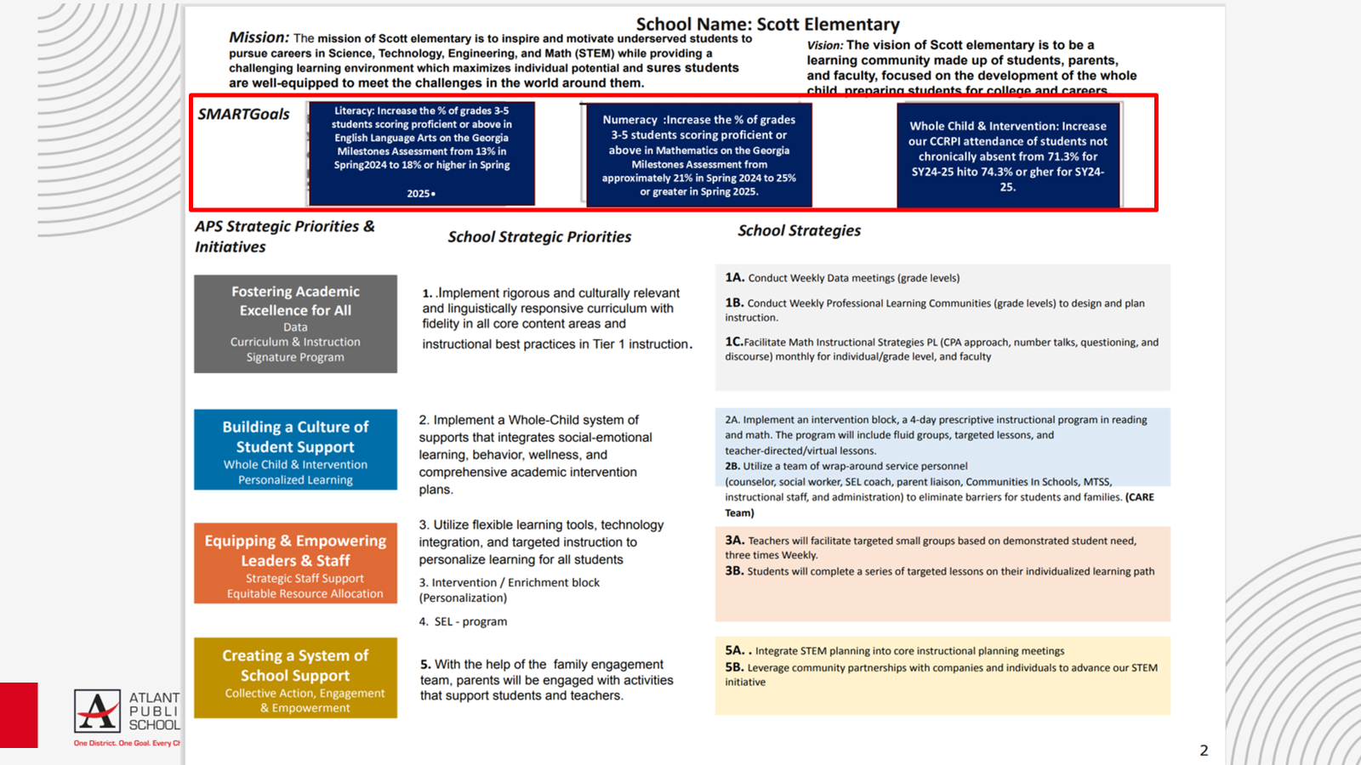
4
Using our new, 2025-2030 Strategic Goals as a guide we will complete a Start, Stop and Continue exercise to review our current “Strategic Priorities” and identify our 2025-2030 Strategic Objectives

Slide 16


Slide 17

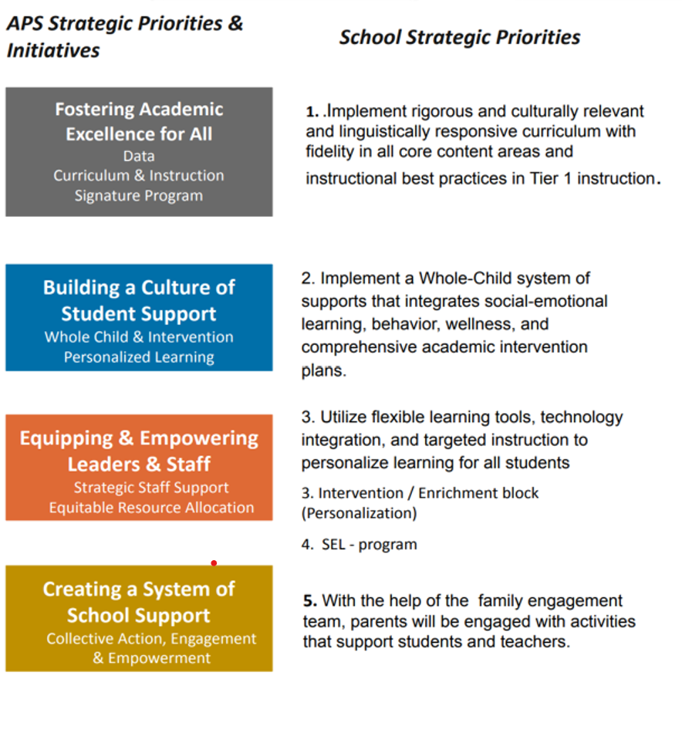
Identifying 2025-2030 Strategic Objectives: Stop Discussion
Guiding Questions:
Stop
- What current priorities/activities are not having the needed impact and should be stopped?
- Are there any priorities/activities that are no longer aligned with our mission, vision, goals or focus areas?
Notes:
Think about what has been working; has been completed; or never started.
If your goals for 2030 are bigger than what you have achieved so far, then what must you do differently going forward?

Slide 18
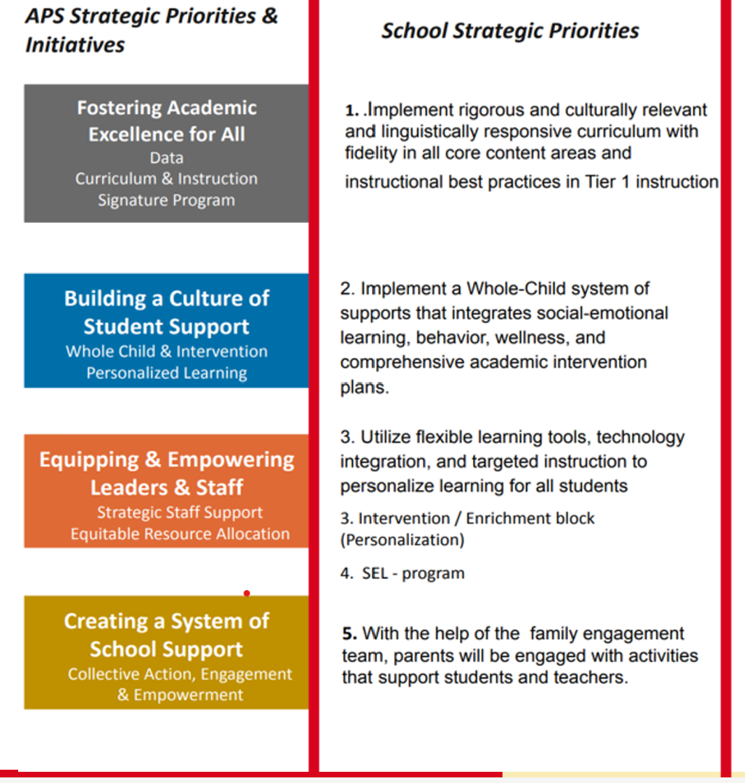

Identifying 2025-2030 Strategic Objectives: Continue Discussion
Guiding Questions:
Continue
- What current priorities/activities are working well and should be maintained?
Notes:
Think about what has been working; has been completed; or never started.
If your goals for 2030 are bigger than what you have achieved so far, then what must you do differently going forward?

Slide 19
Identifying 2025-2030 Strategic Objectives: Continue Discussion
Enter the “Strategic Priorities” from your 2020-2025 Strategic Plan that you and your GO Team think should continue as “Strategic Objectives” on your 2025-2030 Strategic Plan based on today’s discussion.

Slide 20
Aligning Your Objectives to the District's New Focus Areas
“Getting Back to Basics”
“Community of Believers”
We Are Strengthening Our Instructional Core
TBD- Strategic Objective
TBD- Strategic Objective
We Are Caring For Every Child
TBD- Strategic Objective
TBD- Strategic Objective
We Are Sparking Student Curiosity
TBD- Strategic Objective
TBD- Strategic Objective
Our Strength is Our Team
TBD- Strategic Objective
TBD- Strategic Objective
Our Responsibility Is Shared
TBD- Strategic Objective
TBD- Strategic Objective
Our School Is Efficient & Effective
TBD- Strategic Objective
TBD- Strategic Objective
You will now move the Objectives (previously Priorities) you want to “Continue” to the appropriate Focus Area
Use your 2020-2025 Strategic Plan, the APS 2025-2030 Strategic Plan (slide 7) and your school KPI sheet to help categorize your objectives. Please note:
  Fostering Academic Excellence for All is likely aligned to “We Are Strengthening Our Instructional Core” or “We Are Sparking Student Curiosity”
  Building a Culture of Student Support is likely aligned to “We Are Caring For Every Child”
  Equipping & Empowering Leaders & Staff is likely aligned to “Our Strength is Our Team”
  Creating a System of School Support is likely aligned to “Our Responsibility is Shared” or “Our School is Efficient & Effective”
Notes:
Use the APS 2025-2030 Strategic Plan (slide 7) and your school's KPI sheet to help guide your team's discussion of how your objectives align to the district's new focus areas.

Slide 21
Identifying 2025-2030 Strategic Objectives: “Start” Discussion
After you have aligned your Objectives to the appropriate Focus Area, identify any new Objectives the school must start to address the goals in your plan
You should have 1-2 Objectives for each Focus Area.
Use the APS 2025-2030 Strategic Plan (slide 7) and your school KPI sheet for ideas if you need to identify new Objectives.
Focus on the “Getting Back to Basics” Focus Areas first (Strengthening Our Instructional Core, Caring For Every Child, and Sparking Student Curiosity)
Make sure you have something in the “Community of Believers” Focus Areas that support your core work (Strength is Our Team, Responsibility is Shared, System is Effective & Efficient)

Slide 22
Guiding Questions: Are there any new “objectives” we must START to completely address our 2025-2030 Strategic Goals? Do we have 1-2 Objectives to support each Focus Area?
“Getting Back to Basics”
“Community of Believers”
We Are Strengthening Our Instructional Core
TBD- Strategic Objective
TBD- Strategic Objective
We Are Caring For Every Child
TBD- Strategic Objective
TBD- Strategic Objective
We Are Sparking Student Curiosity
TBD- Strategic Objective
TBD- Strategic Objective
Our Strength is Our Team
TBD- Strategic Objective
TBD- Strategic Objective
Our Responsibility Is Shared
TBD- Strategic Objective
TBD- Strategic Objective
Our School Is Efficient & Effective
TBD- Strategic Objective
TBD- Strategic Objective
Notes:
Please Note:
Complete the discussion about what you should “Start” after you have moved the “Continue” Objectives (previously Priorities) to the appropriate “Focus Areas."

Slide 23
Where we’re going
At our next meeting we will:
Vote on the 2025-2030 Strategic Plan
Rank our 2025-2030 Strategic Objectives
Begin the discussion of the 2026-2027 budget
Let me or the Chair know of any additional information you need for our future discussion.

Slide 24

Questions?

Slide 25
Information Items

Slide 26
Principal’s Report

Slide 27
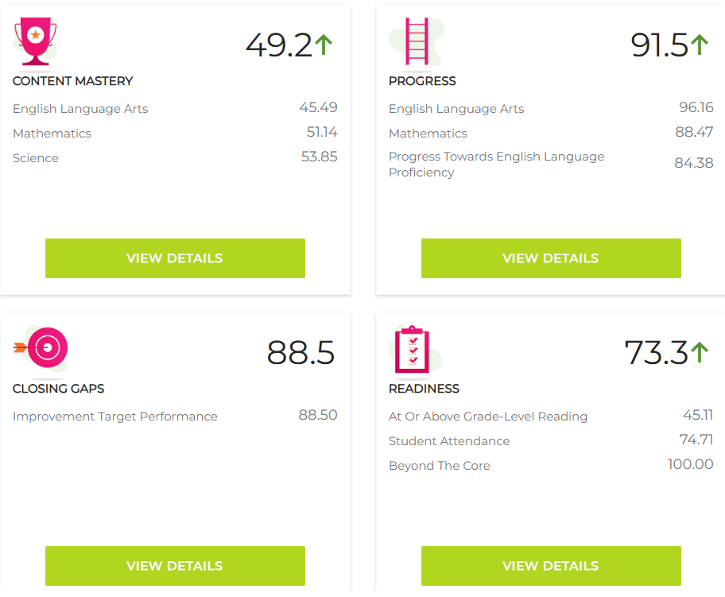
2025 CCRPI Results

Slide 28
SCHOOL UPDATES
MAP Testing
  MAP Growth Reading and Mathematics Dec 3 & 4
  Amira Fluency and MAP Growth Science- the week of Dec 8
Attendance Challenge
  3 weeks before Holiday break
  Polar Express Theme
  “Beat the Clock”
Girls on the Run 12/6
Spelling Bee 12/18
Winter Program 12/19

Slide 29

Cluster Advisory Team Report
Charter System Renewal
FY27 Budget Preparation
Attendance

Slide 30


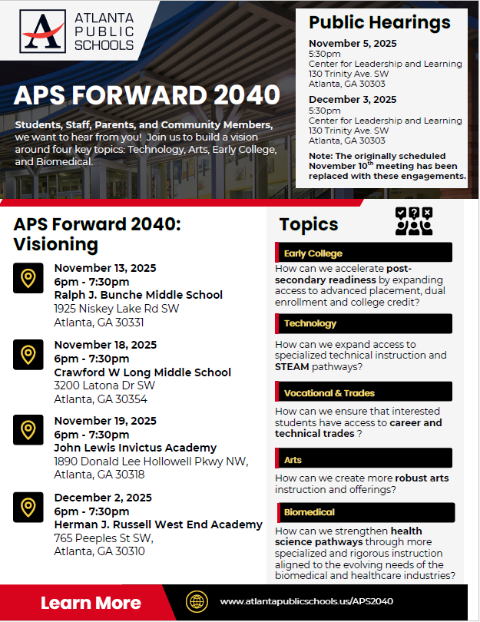

UPDATE
Comprehensive Long-Range Facilities Plan
www.atlantapublicschools.us/APS2040
Notes:
Next on our agenda, we’d like to welcome our representative to the Long-Range Comprehensive Facilities Master Plan Taskforce. As many of you know, this taskforce plays a key role in shaping the future of our district’s facilities — ensuring they are aligned with projected enrollment, instructional needs, safety standards, and long-term community use."
Over the summer, the taskforce has been hard at work reviewing data, exploring options, and engaging in important planning conversations. [Name of Representative] will share an update on what’s been done so far, any key decisions or recommendations that have been made, and what’s ahead — including opportunities for the public to provide input.
[Allow the FMP representative to provide an update and answers questions. After this is concluded:]
Thank you [Name of Representative].
A report will be presented to the Board at its August 11 meeting, and the options will become public the week of August 18.
There are several upcoming public meetings where you can learn more and share your thoughts. The next public meetings are scheduled for: August 25, October 20, and November 10
On each date, there will be a virtual meeting at noon and an in-person meeting at the Central Office at 6PM.
I strongly encourage you all to attend these meetings. This is a critical time for public input, and your voice is essential.

Slide 31
Announcements

Slide 32
Thank you

Slide 33
DRAFT (School Name)
2025-2030 Strategic Plan Template
Mission
Vision
1
Strategic Goal
2
Strategic Goal
3
Strategic Goal
4
Strategic Goal
We Are Strengthening Our Instructional Core
TBD- Strategic Objective
TBD- Strategic Objective
We Are Caring For Every Child
TBD- Strategic Objective
TBD- Strategic Objective
We Are Sparking Student Curiosity
TBD- Strategic Objective
TBD- Strategic Objective
Our Strength is Our Team
TBD- Strategic Objective
TBD- Strategic Objective
Our Responsibility Is Shared
TBD- Strategic Objective
TBD- Strategic Objective
Our School Is Efficient & Effective
TBD- Strategic Objective
TBD- Strategic Objective

